Slide 1

Understanding how a program works
Behram Khan

Slide 2
Lecture Overview
In this first lecture we will cover the fundamental theoretical concepts that form the backbone of programming.
This session focuses solely on theory, providing a solid foundation for understanding computers and programming
Involving examples and interactive session to develop problem solving

Slide 3
Learning Objectives
By the end of this lecture, students will be able to:
Know about programming languages
How high level languages are translated to low level
Understand basic hello world program structure.

Slide 4
Recap
Timing Signal
Control Signal
CIR Register
IBR Register
Notes:
A timing signal is a clock signal used by the processor to synchronize various operations within the CPU, ensuring that instructions and data move through the system in a coordinated manner.
Control signals are commands sent by the control unit of the CPU to various parts of the system (like memory, ALU, registers, etc.) to execute certain tasks.
CIR (Current Instruction Register) is a special register in the CPU that holds the instruction currently being executed or processed.
When an instruction is fetched from memory, it is stored in the CIR before being decoded and executed.
Instruction Buffer Register (IBR) is a register used to temporarily store the next instruction fetched from memory, allowing the CPU to pre-fetch instructions.

Slide 5
Recap
The CPU reads the instruction 5 + 3 and stores it in CIR.
The MAR is set to the memory addresses where 5 and 3 are stored.
The MDR retrieves the values 5 and 3 from those addresses.
The ACC performs the addition (5 + 3) and stores the result (8).
The PC moves to the next instruction's address.
The IBR prepares the next instruction, allowing it to be quickly accessed once the current instruction is complete.
Notes:
A timing signal is a clock signal used by the processor to synchronize various operations within the CPU, ensuring that instructions and data move through the system in a coordinated manner.
Control signals are commands sent by the control unit of the CPU to various parts of the system (like memory, ALU, registers, etc.) to execute certain tasks.
CIR (Current Instruction Register) is a special register in the CPU that holds the instruction currently being executed or processed.
When an instruction is fetched from memory, it is stored in the CIR before being decoded and executed.
Instruction Buffer Register (IBR) is a register used to temporarily store the next instruction fetched from memory, allowing the CPU to pre-fetch instructions.

Slide 6
Recap
What is Logic?
Transmitted
General Purpose and Specific Purpose Computers
Notes:
The term "transmitted" refers to the act of sending or conveying something from one place to another, typically used in the context of signals, information, or data.
When data is transmitted, it changes forms. Like audio to digital and digital back to audio
Transfer" refers to the act of moving something from one location to another. This can involve data, ownership, or responsibility.

Slide 7
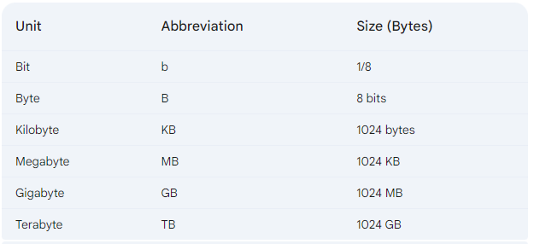
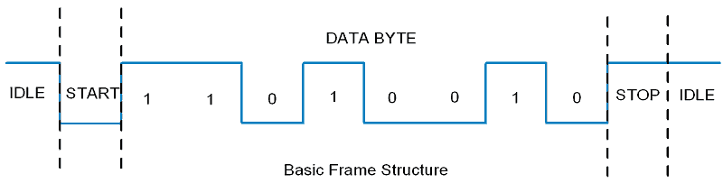
Recap : Unit Of Memory
What is Bit?
Smallest unit of data that a
computer can process and store.
1,0
Voltage States

Slide 8
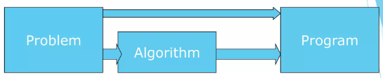
Algorithm
Step by step instructions to solving a problem
Sequence of English statements
It is not a program
Algorithm can be expressed as a pseudo code or a flowchart.

Slide 9
Algo : Average of two numbers
Input two numbers
Add the numbers
Divide the result by 2
Display the result

Slide 10
Algo : Student has passed or failed
Input Marks
If( Marks are greater than or equal to 40)
Then set grade to pass
Else set grade to fail
Display the grade

Slide 11
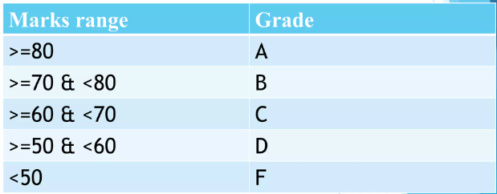
Algo : Write algorithm for grading system

Slide 12
Algo : Student has passed or failed
Get the student's marks.
Check if the marks are between 80 and 100, inclusive.
If true, assign the grade "A".
If not, check if the marks are between 70 and 79, inclusive.
If true, assign the grade "B".
If not, check if the marks are between 60 and 69, inclusive.
If true, assign the grade "C".
If not, check if the marks are between 50 and 59, inclusive.
If true, assign the grade "D".
If not, assign the grade "F".

Slide 13
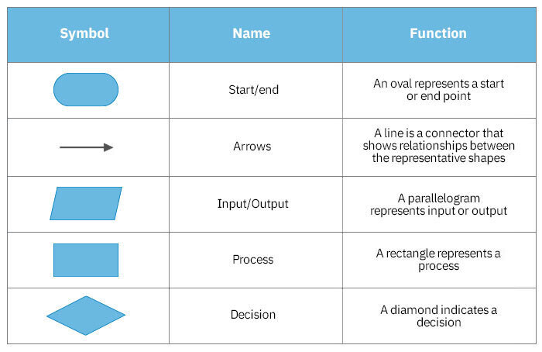
Flowchart
Graphical representation of an algorithm.
Helps see the flow of logic

Slide 14
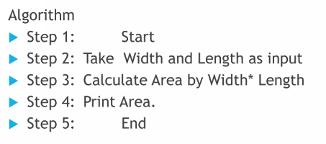
Flowchart
Write an algorithm and draw a flowchart that will read the two sides of a rectangle and calculate its area.

Slide 15
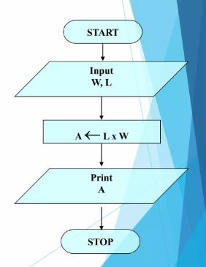
Flowchart

Slide 16
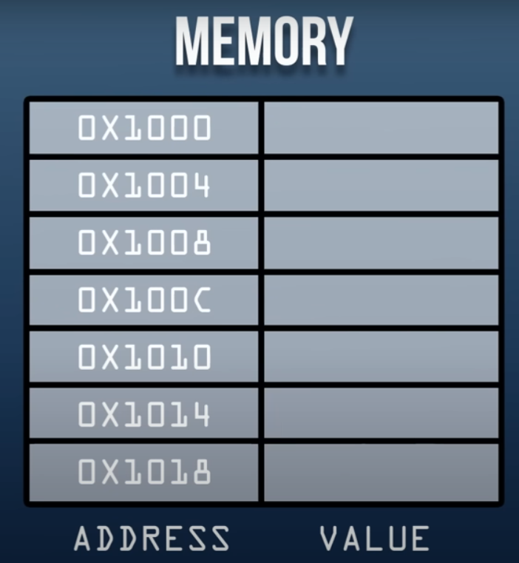

Memory
Temporary storage place
Volatile vs Non-Volatile (RAM vs ROM)
Memory has addresses
4000

Slide 17
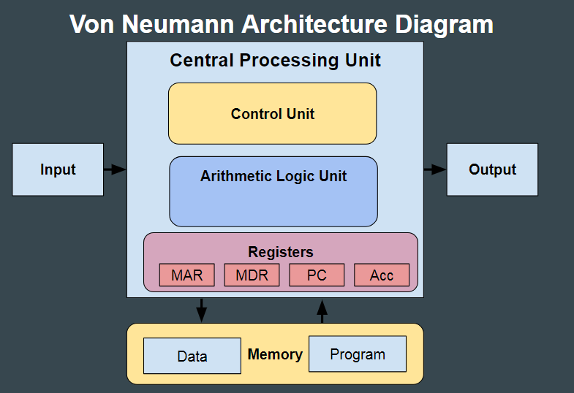
Working of Architecture
Student in class Analogy
Human as CPU
CU
ALU
Registers
Hands as Buses
Bag as storage
Handle as RAM
4000
Notes:
Human (CPU): You, the human, represent the CPU (Central Processing Unit). The CPU is responsible for executing tasks and making decisions, just like you're the one thinking and performing actions.
Hands (Buses): Your hands act as the buses, which move data between different parts of the system.
Bag (Storage Device): Your bag represents the storage device (like a hard drive or SSD), where you keep things for long-term storage, like books (data).
Handle (Memory/RAM): The handle where you put things (like a book you're actively reading) represents RAM (Random Access Memory), which stores data temporarily while you're working with it.
Now, let's walk through the steps:
Fetching Data from Storage:
You reach into your bag (storage) and see three books inside.
Your brain (CPU) thinks, "I need the programming book."
The Control Unit (CU), part of the CPU, tells your hands (buses) to check the books.
The Arithmetic Logic Unit (ALU) checks the titles and finds the "Programming" book.
Placing Book in RAM:
After finding the programming book, you take it out of the bag and put it on the handle (RAM), which represents short-term memory, where you can access the book quickly while you're using it.
The book is now in RAM, ready for quick access during the class.
Registers – Temporary Working Space:
Before you open the book, you make a quick mental note of the task: "Open page 300." This small mental note represents the registers, which are tiny, super-fast memory spaces inside the CPU where small bits of data (like instructions or addresses) are temporarily held while being processed.
Registers hold information for immediate tasks (like the page number) and speed up the process by avoiding the need to fetch this data from RAM every time.
Execution – Page Navigation:
You open the book to page 250, but it's not the page you need.
Your brain (CPU) reads the instruction to go to page 300.
The Control Unit sends a signal to the ALU, which processes, "250 < 300, so I need to flip forward 50 pages."
You flip through the pages and stop at page 300. Now, you're ready to read (or execute the task).
Putting Data Back into Storage:
After class, you close the book, and since you're done with it, you place it back into your bag (storage device). It’s no longer on the handle (RAM), which means it's no longer in the system’s active memory.

Slide 18
How is Hello World Displayed?

Slide 19
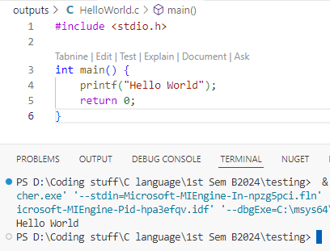

Slide 20
Programming Languages
Programming languages define a set of instructions for the CPU (Central Processing Unit) for performing any specific task.
2 types
Low level Language
High Level Language

Slide 21
Low Level Languages
Computer only understands Machine Code or Binary Language 1 and 0’s.
Machines can easily understand it
Harder to write
They are not very easy to understand
Not Portable
Assembly Language : Symbolic representation of a computer’s machine code.
ADD, SUB, MOV, STR
Notes:
STR: Store a value to memory.
ADD: Add two values.
SUB: Subtract one value from another.
MOV: Move data from one location to another.

Slide 22
High Level Languages
Closer to human languages and are easier to read and write.
Can run on multiple platforms
C, C++, Java, Python
Notes:
STR: Store a value to memory.
ADD: Add two values.
SUB: Subtract one value from another.
MOV: Move data from one location to another.

Slide 23
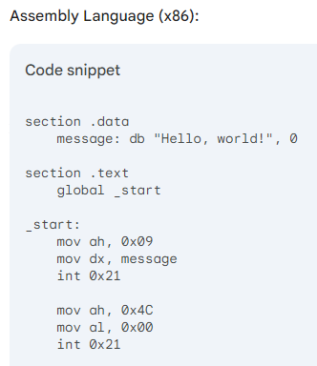
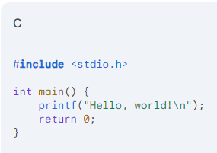
Difference?
Level of abstraction(hiding unnecessary details)
Notes:
STR: Store a value to memory.
ADD: Add two values.
SUB: Subtract one value from another.
MOV: Move data from one location to another.

Slide 24
Now how will computer understand high level language as it only understands machine language (1 and 0’s)? WE TRANSLATE IT INTO LOW LEVEL LANGUAGE

Slide 25
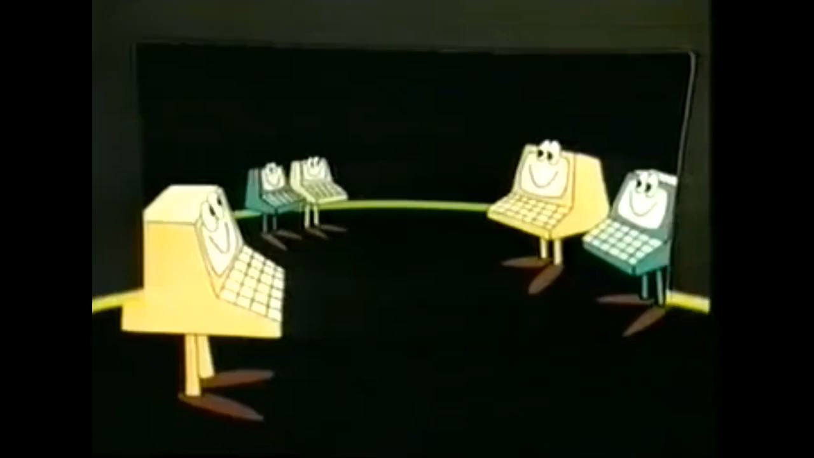
Notes:
https://www.youtube.com/watch?v=_C5AHaS1mOA

Slide 26
Interpreter
An interpreter reads the source code line by line or statement by statement and executes it directly.
• There is no intermediate object code or executable file generated.
When the program runs
the interpreter processes the source code line by line
The interpreter reads one line of code
It translates that line into machine code and executes it immediately
Then it moves to the next line and repeats the process.
The interpreter must be present to execute the code, meaning that the user must have the interpreter installed to run the program.

Slide 27



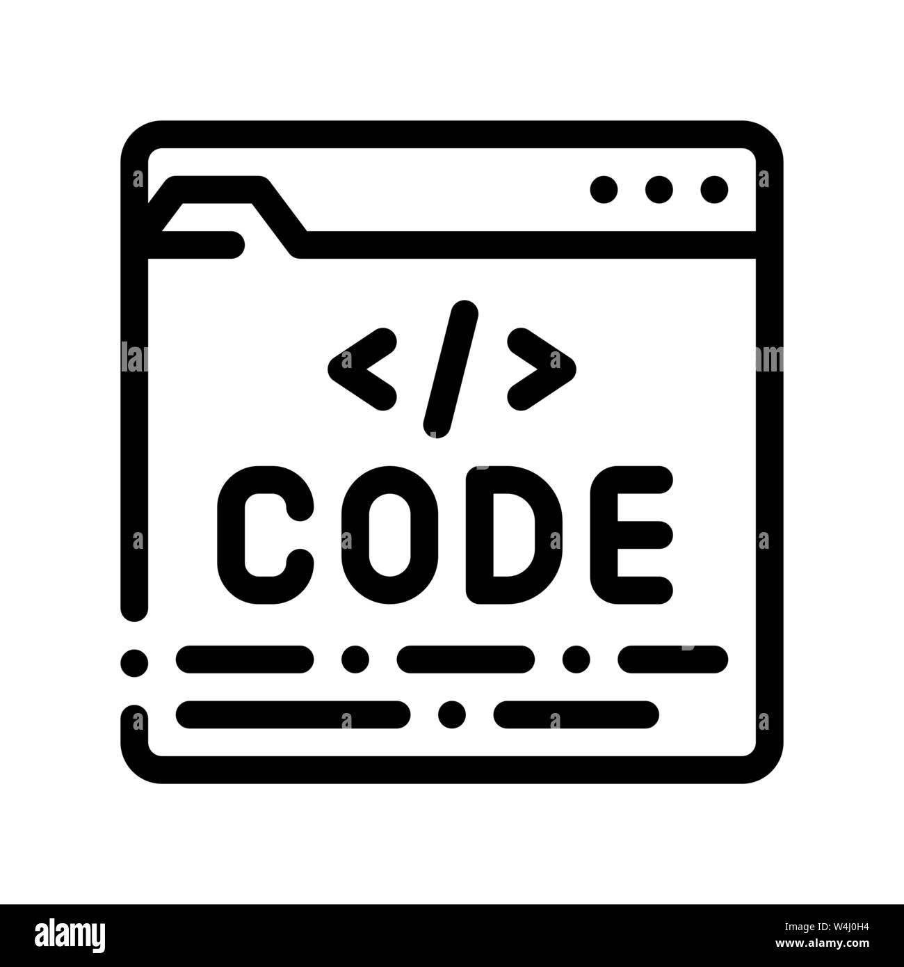
Interpreter
Have to share source code with interpreter every time.
Displayed on screen
(Can be slow due to slower interpreter)
Make a copy
Have Interpreters installed

Slide 28
Compiler
A compiler takes the entire source code of a program written in a high-level language and translates it into an object code or machine code.
The output of the compilation process is typically a standalone executable file that can be run on the target machine without the need for the original source code or the compiler.
Compilation is done before the program runs
Any changes to the source code require recompilation.
Specific to platform (Architecture), Not cross independent

Slide 29
Compiler
Compiler
Object Code
Linker
Machine Code 1 and 0
HelloWorld.c
Executable File
Linker
HelloWorld.exe
Converts Object Code into Executable File
Notes:
gcc hello.c
gcc file.c -o name.exe
.\name.exe

Slide 30
Loader
Loads file into memory when we execute it
Executable File
Memory/RAM
Allocates memory to the program
Notes:
gcc hello.c
gcc file.c -o name.exe
.\name.exe

Slide 31
Why Program In C Language

Slide 32
C Language
The C programming language is a procedural (step by step, top to bottom) and general-purpose.
Foundation of Modern Languages: C serves as the foundation for many programming languages (like C++, C#, and Objective-C). Understanding C helps grasp the concepts of other languages more easily.
Need compiler GCC
Widely used for system programming, embedded systems, Game Development

Slide 33
Understand Program
#
Include
Header File
STDIO.H
Main Function
Body
Printf
String in double quotes (apostrophes)
Semicolon/Terminator

Slide 34
# and Include
# is called preprocessor directive
It tells the compiler to perform some special task
Include keyword give command/instruction to include the <stdio.h> header file in our program.
#include statement is like a toolkit, before we start doing our work, we take our tools out of it.
We are telling the compiler to open a "toolbox" that contains important tools (functions) needed for input and output tasks, such as displaying text on the screen or reading input from the keyboard.

Slide 35
Header file
Header file is a file which contains functions
f(x) = 2x + 1.
This function takes an input (x) and performs an operation on it (multiply by 2 and add 1) to produce an output.
In programming, a function is similar. It takes input values, performs a series of operations, and returns an output value.
<stdio.h> stands for Standard Input Output library
Stdio contains functions and instructions to display output and take input.
Notes:
Library vs header file
Header file only has definition of methods and its prototype
Library has its implementation, the actual code which runs and does the tasks.

Slide 36
Main Function
A Function which tells the compiler where our program starts from.
Every C program must have a main function/starting point of the program.
We write int before main to get error message.
Tells us if our program ran successfully or not.
We add () parenthesis after main to tell compiler this is a function.
We add { and } to tell compiler the starting and ending point of our program.
This is just the way functions are written.

Slide 37
Terminator
Tells compiler where our statement ends

Slide 38
Q/A?
Recap:
Programming Languages
High level
Low Level
Interpreter and Compiler
C Program basic structure

